Slide 1

Note: The data and information in this document is reflective of a hypothetical situation and client. This document is to be used for KPMG Virtual Internship purposes only.
Sprocket Central Pty Ltd
Data analytics approach
[Data Analyst]

Slide 2
Note: The data and information in this document is reflective of a hypothetical situation and client. This document is to be used for KPMG Virtual Internship purposes only.
Agenda
Introduction
Data Exploration
Model Development
Interpretation

Slide 3
Note: The data and information in this document is reflective of a hypothetical situation and client. This document is to be used for KPMG Virtual Internship purposes only.
Introduction
Sprocket Central Pty Ltd is a long-standing KPMG client whom specialises in high-quality bikes and accessible cycling accessories to riders.
Their marketing team is looking to boost business by analysing their existing customer dataset to determine customer trends and behaviour.
The dataset contain 5 sheets

Slide 4
Note: The data and information in this document is reflective of a hypothetical situation and client. This document is to be used for KPMG Virtual Internship purposes only.
Data Exploration
Here first we have to do ETL operations ie. Extract Transform loading the data
so lets work:-
1) Remove all NA from Dataset.
2) Create pivot of Count of product_id, Min of Recency, Sum of Profit
3) Find out recency by subtracting date of transaction and date of comparison
4) Now transform the data by finding out quartiles of recency code
5) Find out the R_score, F_score, M_score
6) Now do RFM analysis
7) splitting columns according to data type
8) scaling numeric columns and convert categorical data into dummy_variables
9) concat the dataset and work for model building

Slide 5
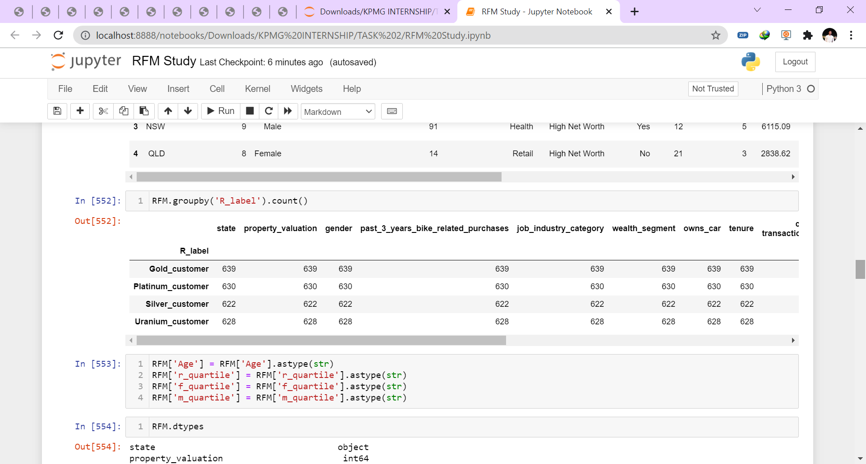
Note: The data and information in this document is reflective of a hypothetical situation and client. This document is to be used for KPMG Virtual Internship purposes only.
Data Exploration

Slide 6
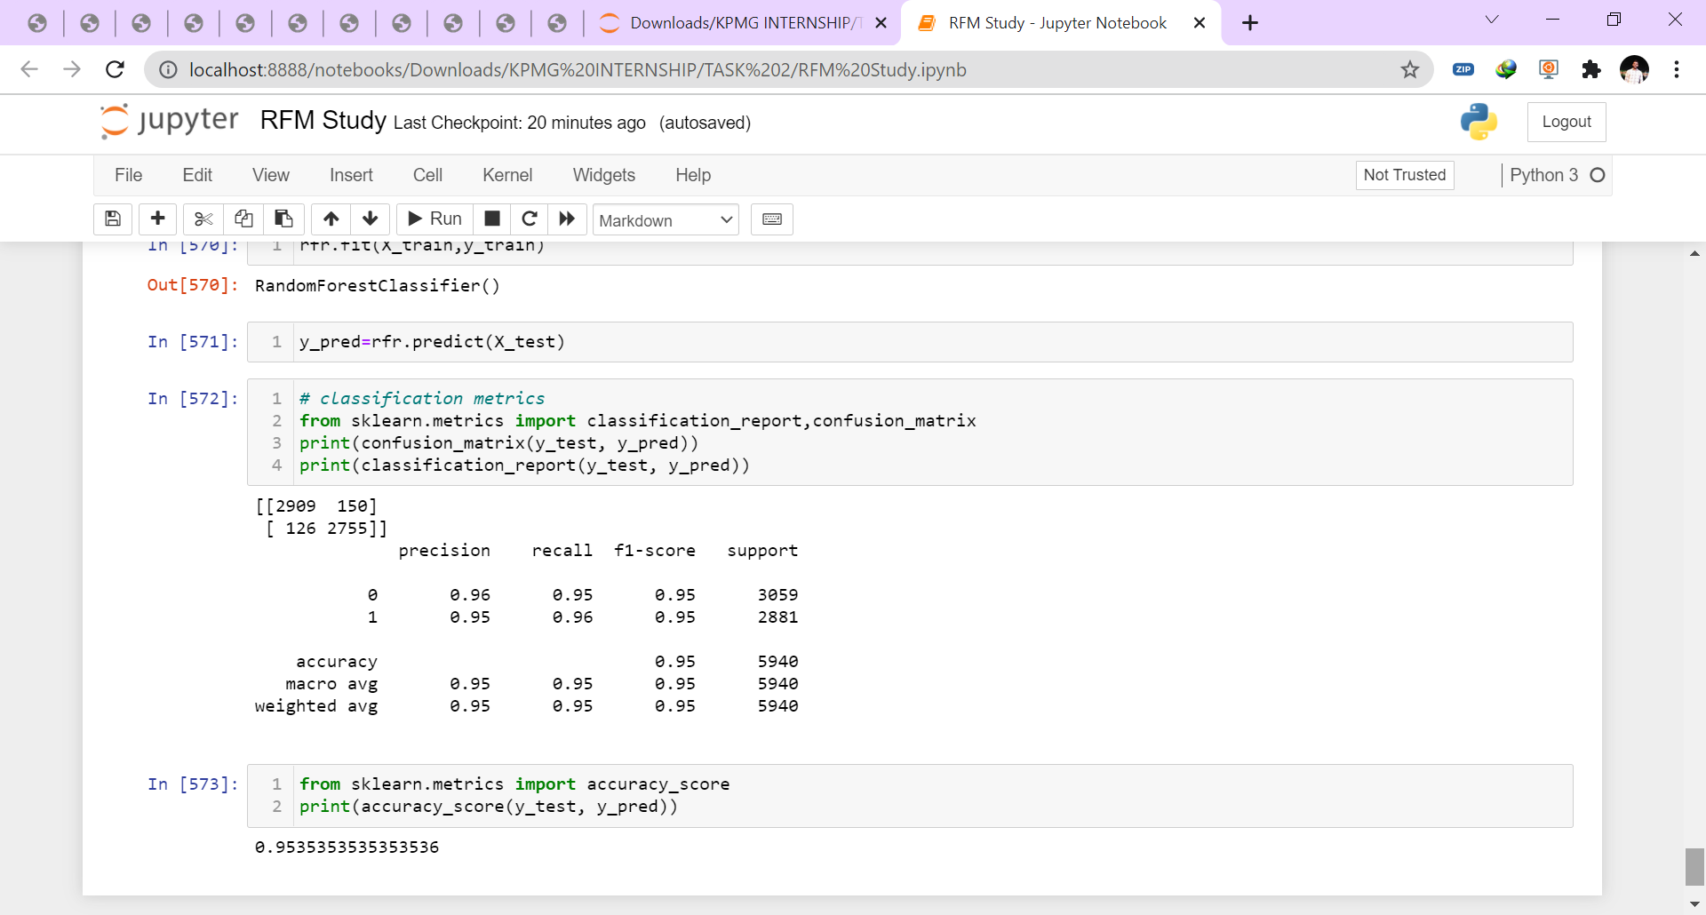
Note: The data and information in this document is reflective of a hypothetical situation and client. This document is to be used for KPMG Virtual Internship purposes only.
Model Development
So After Data exploration our Dataset is ready for modelling.
Here as the distribution is unequal so we have resampled data of data type object.
Now, lets start I have done data modelling with the help of ensemble technique of Random Forest
So Lets fit the dataset to random forest classifier algorithm and find out the accuracy
I got the accuracy, Confusion matrix, and classification report as shown in diagram
we got the accuracy of 95% which is much accurate for us..

Slide 7
Note: The data and information in this document is reflective of a hypothetical situation and client. This document is to be used for KPMG Virtual Internship purposes only.
Interpretation

Slide 8
Note: The data and information in this document is reflective of a hypothetical situation and client. This document is to be used for KPMG Virtual Internship purposes only.
Submitted by
Viki P. Yeole

